Slide 1

AI-Driven Academic Risk & Dropout Early-Warning System
Presented by
Altrin Benser A - 962223205010 John Jins J - 962223205032
Jerish Rethna J - 962223205029 Mukhilan S - 962223205040
Guide:
Er. Agnes Alex Rathy P
Assistant Professor/IT

Slide 2
Abstract
Traditional academic systems mainly identify weak students after semester or examination results and treat student information as static records. This limits continuous monitoring and early intervention for academically struggling students.
Our proposed Digital Class Twin continuously collects student attendance, assessment, quiz and behavioral data as events. It maintains an evolving digital representation of each student’s academic state over time.
Machine learning techniques analyse these data to identify and classify students based on their academic risk.

Slide 3
Problem Statement
Existing Problems
  Weak students are often identified only after examination/semester results.
  Student data is commonly maintained as static records.
  Static records do not adequately represent changing student performance over time.
  Rule-based approaches such as attendance thresholds cannot capture the complete academic situation.
  Institutions lack a mechanism for continuous monitoring and early intervention.
Need for the project
To design a system that can continuously monitor student progress, identify declining academic students at an early stage, and provide understandable evidence to teachers and counselors.

Slide 4
Objectives
To collect student academic data such as attendance, internal marks, assignment marks, lab scores, and behaviour records using APIs and Excel/CSV uploads.
To create a digital profile for every student that automatically updates based on the latest 30 days of academic activities.
To calculate student performance scores (0–100) using Machine Learning and classify students into three levels: Stable, Warning & Critical.
To provide a simulation feature that allows students and faculty to check how improvements in attendance and marks can affect performance without changing actual records.
To provide secure, role-based dashboards and automatic alerts for students, faculty mentors, and parents.

Slide 5
Related Sustainable Development Goals (SDG)
PRIMARY SDG
SDG 4: Quality Education
SDG 10: Reduced Inequalities
SECONDARY SDG
SDG 10
Early identification can help students who need extra academic support
Supports more equitable access to timely guidance
A supporting link, not a claim to remove inequality
SDG 4
Closest match to our project objective
Early identification of academically at-risk students for timely support
SDG 9: Industry, Innovation & Infrastructure
SECONDARY SDG
Risk score from academic performance, attendance and behavior
Low / Moderate / High levels show who needs help first
Dashboards let teachers and parents act early
Aims to improve educational outcomes and reduce dropout
SDG 9
Applies digital-twin concepts to student academic profiles
Data-driven analytics and digital dashboards in education
Rule-based risk engine today; trained ML planned
The project primarily contributes to SDG 4 by supporting early identification of academic risk and timely educational intervention.

Slide 6
Existing System
1. Separate & Fragmented Storage
2. Delayed Performance Processing
• Data Silos: Attendance, CIA marks, lab scores, and conduct records are kept in separate sheets or ERP modules.
• No Unified View: Faculty cannot see a student's complete semester standing in one centralized profile.
• Late Detection: Attendance % and overall grades are calculated only monthly or at the end of the semester.
• Missed Recovery Window: Too late to arrange remedial classes or meet the 75% Anna University attendance limit.
3. Static Risk Scores
4. No Interactive What-If Simulation
• No Explainability (XAI): Existing tools output raw risk percentages without explaining the root cause.
• Hidden Volatility: Fails to distinguish steady learners from students with erratic test score swings.
• Static Dashboards: Traditional ERPs only display past records without forward-looking recovery projections.
• No Actionable Planning: Students and mentors cannot simulate how many classes or marks are needed to recover.

Slide 7
SI NO. | Author(s) & Year | Paper Title | Dataset / Application | Method / Technique Used | Limitations | Key Findings
1 | Cagliero et al. (2021) | Predicting Student Academic Performance by Means of Associative Classification | Learning analytics/course data | • Associative classification • Early exam-success prediction | • Course/exam focused • No continuous Digital Twin or intervention history | • Early data can predict exam success • Supports targeted help for at-risk students
2 | Karalar et al. (2021) | Predicting Students at Risk of Academic Failure Using Ensemble Model During Pandemic in a Distance Learning System | Moodle + Adobe Connect | • Ensemble ML • GB, QDA, DT, RF, ET, LR, ANN | Pandemic/distance-learning context Limited continuous multi-source monitoring | Ensemble model identified at-risk students Asynchronous activity was highly informative
3 | Park & Yoo (2021) | Early Dropout Prediction in Online Learning of University Using Machine Learning | University online-learning data | • ML classification • Early dropout prediction | Online-learning focused No persistent student-state model or intervention loop | ML can identify potential dropouts early
4 | Dabhade et al. (2021) | Educational Data Mining for Predicting Students’ Academic Performance Using Machine Learning Algorithms | Academic, personal and behavioral data | •Educational Data Mining •Comparative ML | •Conventional prediction approach • No Digital Twin or closed-loop intervention | • Multiple student factors support performance prediction

Slide 8
5 | Tamada et al. (2022) | Predicting Students at Risk of Dropout in Technical Course Using LMS Logs | • Random Forest, DT, NB • K-means + feature engineering | • 1 million Moodle logs | • RF performed strongly • LMS engagement was useful for early prediction | • LMS/technical-course focused • Broader academic and behavioural events not integrated
6 | Yağcı (2022) | Educational Data Mining: Prediction of Students’ Academic Performance Using Machine Learning Algorithms | • Educational Data Mining • Supervised ML | • Student academic dataset | • ML identified patterns linked to academic achievement | • Dataset-level prediction • No continuously updated student state
7 | Oqaidi et al. (2022) | Towards a Students’ Dropout Prediction Model in Higher Education Institutions Using Machine Learning Algorithms | • ML classification • Feature selection + evaluation | • Higher-education student data | Feature selection and model choice affect dropout prediction | • Prediction focused • No Digital Twin or intervention feedback
8 | Segura et al. (2022) | Machine Learning Prediction of University Student Dropout: Does Preference Play a Key Role? | • SVM, DT, ANN, LR • Feature analysis | • University of Madrid • 28 variables | • First-semester performance improves dropout detection • Course preference is relevant | • Very-early prediction remains limited • Single institutional context

Slide 9
9 | Katsuragi & Tanaka (2022) | Dropout Prediction by Interpretable Machine Learning Model Towards Preventing Student Dropout | • Interpretable ML • Learning+ communication features | • Online-school data • Daily learning + Slack activity | • Behaviour and communication can support dropout prediction | • Online context • No multi-source Digital Twin
10 | Su et al. (2022) | Applying Machine Learning Tecnologies to explore Students Learning Features and performance Prediction | • RF, SVM, LR, NN • Correlation analysis | • Programming- course quizzes + system logs | • Learning behaviour correlated with performance • NN performed well | • Programming-course focused • Limited broader academic/behavioural data
11 | Plak et al. (2022) | Early Warning Systems for More Effective Student Counselling in Higher Education | • LR, additive LR, SVM, RF • Early-warning + counseling | • VU Amsterdam • Two first-year cohorts | •Prediction can support student-specific counselling | • Institution-specific •Intervention depends on local counselling practice
12 | Qin et al. (2023) | Early Warning of Student Performance With Integration of Subjective and Objective Elements | • Neural network • Multi-source data synthesis + cost-sensitive learning | • University records • Academic,library, registration, access- control data | • Combining academic + behavioural factors improved warning | • Institution-specific integration • Deep-model interpretability remains challenging

Slide 10
13 | Cho et al. (2023) | A Study on Dropout Prediction for University Students Using Machine Learning | • Machine learning • Dropout prediction + feature analysis | •University student records | • ML identified useful dropout-related factors | • Dropout focused • No continuous state tracking or intervention loop
14 | Balcioğlu & Artar (2023) | Predicting Academic Performance of Students with Machine Learning | • DT, SVM, NN • Ensemble model | • OULAD | • Ensemble achieved strong prediction performance | • Performance prediction focused • No persistent twin + XAI intervention workflow
15 | Nagy & Molontay (2023) | Interpretable Dropout Prediction: Towards XAI-Based Personalized Intervention | • ML dropout prediction • Explainable AI | •Higher-education student data | • Interpretability can support personalized intervention | • Mainly prediction + explanation • No event-driven Digital Twin trajectory
16 | Villar & Robledo Velini de Andrade (2024) | Supervised Machine Learning Algorithms for Predicting Student Dropout and Academic Success: A Comparative Study | • DT, SVM, RF, GB, XGBoost, CatBoost, LightGBM • SMOTE/ADASYN + SHAP | •Higher-education dataset | • Boosting models performed strongly • SHAP supported factor interpretation | • Single-dataset dependence • Minority-class prediction remains challenging

Slide 11
17 | Vaarma & Li (2024) | Predicting Student Dropouts with Machine Learning: An Empirical Study in Finnish Higher Education | • ML prediction • Monthly longitudinal feature analysis | • Finish higher education •Transcript + demographic + Moodle data | • Credits, failed courses and Moodle activity were important • Feature importance changes over time | • Single-university confidential data • Requires continual updating
18 | Tiukhova et al. (2024) | Explainable Learning Analytics: Assessing the Stability of Student Success Prediction Models by Means of Explainable AI | • Predictive learning analytics • SHAP + model-stability/drift analysis | • Student success prediction data | • SHAP helps assess feature importance and stability •Importance changes across contexts | • Explainability focused • Not a complete early- warning/intervention platform
19 | Miranda et al. (2024) | Machine Learning's Model-Agnostic Interpretability on the Prediction of Students' Academic Performance in Video-Conference-Assisted Online Learning | • RF, SVM,GNB • SMOTE + SHAP | • 361 online-learning records | • RF performed strongly • SHAP identified important performance factors | • Small, context-specific dataset • Online/pandemic context limits generalization
20 | Alalawi et al. (2025) | An Extended Learning Analytics Framework Integrating Machine Learning and Pedagogical Approaches for Student Performance Prediction and Intervention | •Predictive ML + pedagogical intervention • Web-based learning analytics framework | • Course assessment data • Academic pilot | • Connects prediction with intervention • Web framework supports academics | • Intervention depends on academics • Continuous multi-source event integration remains open
Notes:
3

Slide 12
Literature Survey , Summary and Research Gap
Research Gap
Major Methods
  Many studies use static or institution-specific datasets.
  Most focus mainly on prediction rather than continuous monitoring.
  Limited integration of academic, attendance and behavioural events.
  Few systems connect predictions directly with interventions.
  Machine Learning: Random Forest, Decision Tree, SVM, Logistic Regression
  Ensemble & Boosting methods for dropout prediction
  Educational Data Mining and Learning Analytics
  SHAP / Explainable AI for prediction interpretation
  Digital Twin & graph-based student pathway modelling
Key Findings
Relevance to Our Project
  ML can predict academic performance and dropout risk at an early stage.
  Attendance, academic performance, LMS activity and behaviour are important indicators.
  Combining multiple student data sources improves risk prediction.
  XAI helps identify the factors influencing predictions.
  Our Digital Class Twin extends existing ML and Digital Twin approaches.
  Uses event-driven continuous monitoring and time-series student state.
  Provides Low/Medium/High risk, GPA prediction and trajectory-based urgency.
  Uses SHAP, What-If simulation and intervention logging for actionable decisions.

Slide 13
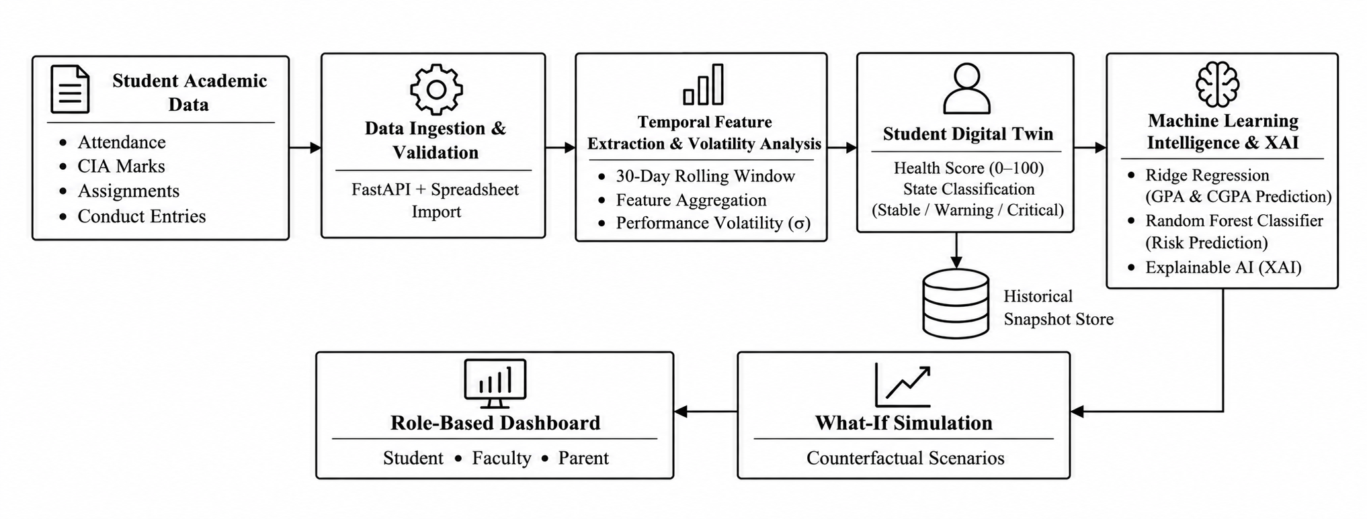


System Architecture

Slide 14
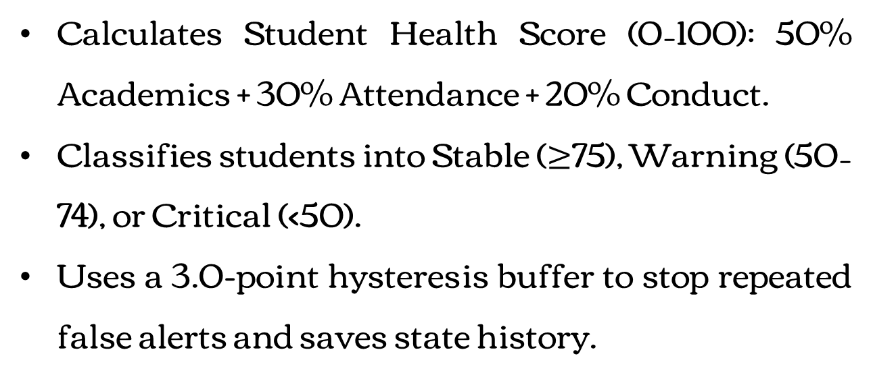
Module Description
Layer 1: Data Ingestion & File Import
Layer 2: 30-Day Rolling Analytics
Collects daily attendance, CIA marks, lab scores, and conduct logs via FastAPI REST APIs.
Supports bulk Excel / CSV file uploads with automatic column detection.
Validates data using Pydantic v2 schemas and stores records in SQLite.
Continuously tracks student performance over the last 30 days instead of waiting for end-semester exams.
Calculates 4 live metrics: Attendance %, Academic Average, Conduct Score, and Grade Volatility.
Checks a minimum of 3 sessions to avoid false early-semester alerts.
Layer 3: Health Score & State Machine
Calculates Student Health Score (0–100): 50% Academics + 30% Attendance + 20% Conduct.
Classifies students into Stable ($≥$75), Warning (50–74), or Critical (<50).
Uses a 3.0-point hysteresis buffer to stop repeated false alerts and saves state history.

Slide 15
Layer 4: ML Risk & Grade Prediction
Layer 5: What-If Simulation
Random Forest Classifier predicts student dropout risk (Low, Medium, High).
Ridge Regression predicts expected semester SGPA and overall CGPA.
Explainable AI (SHAP) clearly shows why a student is at risk.
Creates a temporary in-memory "Shadow Twin" without changing real database records.
Lets students and faculty test future attendance % and target exam marks.
Calculates how many classes or marks are needed to reach the 75% Anna University limit.
Layer 6: Role-Based Portals & Alerts (FR6–8)
Interactive React 18 dashboards for Students, Faculty Mentors, and Parents.
Automatically sends alerts to mentors and parents when a student enters Warning or Critical.
Secured with JWT & Bcrypt so parents can view only their own child's record.

Slide 16
Implementation Details (Framework, Design)
Layer | Technologies
Frontend | React 18
Backend | Python, FastAPI
Database | SQLite 3, SQLAlchemy 2.0
Security | JWT, Role-Based Access Control (RBAC)
ML engine | Random Forest Classifier, Ridge Regression, Explainable AI
Notes:
Here are the implementation details. For the framework: React with Vite and Axios on the frontend; Python with FastAPI, Uvicorn and Pydantic on the backend; SQLAlchemy with SQLite for development and Alembic for migrations; JWT with password hashing and role-based access for security; and Git, Swagger and Postman as tools. The design is split into four modules: backend, client app, ML engine and shared contracts. We have role-based dashboards for student, teacher, parent and admin, backed by REST routers for authentication, events, twins, insights, alerts and more.

Slide 17
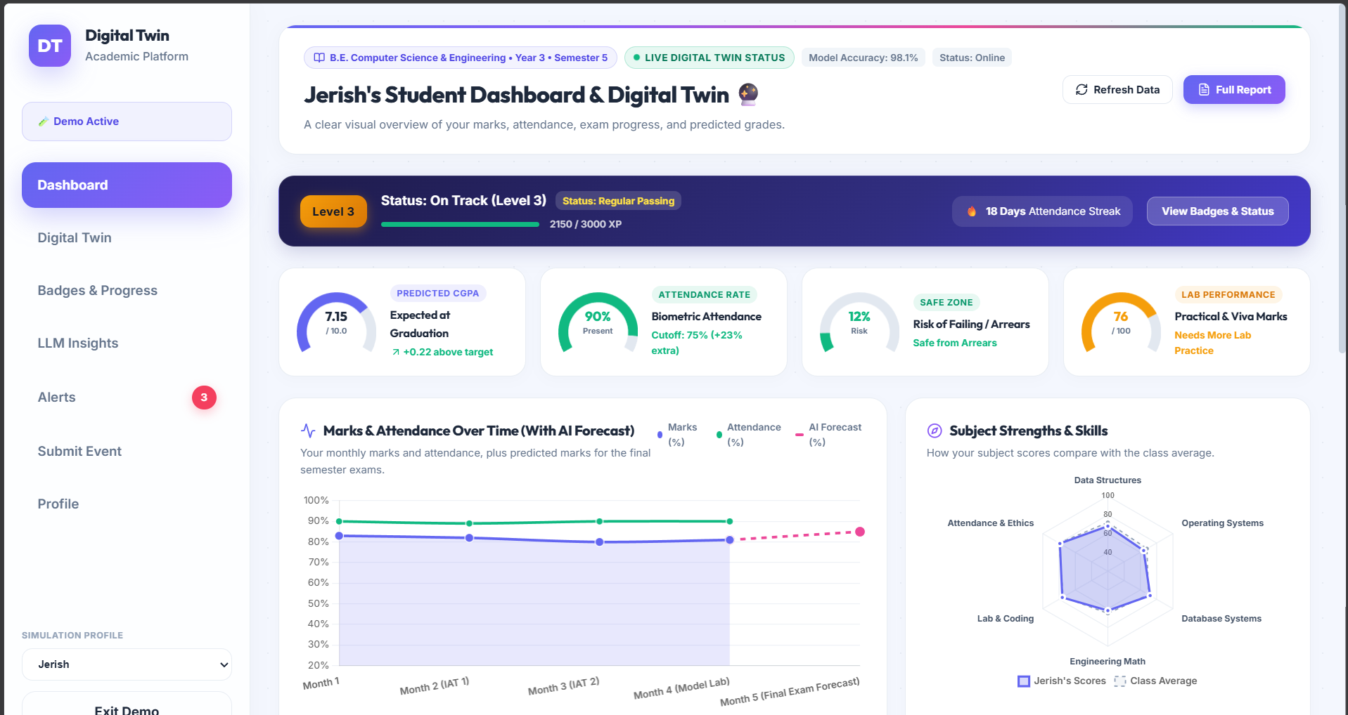
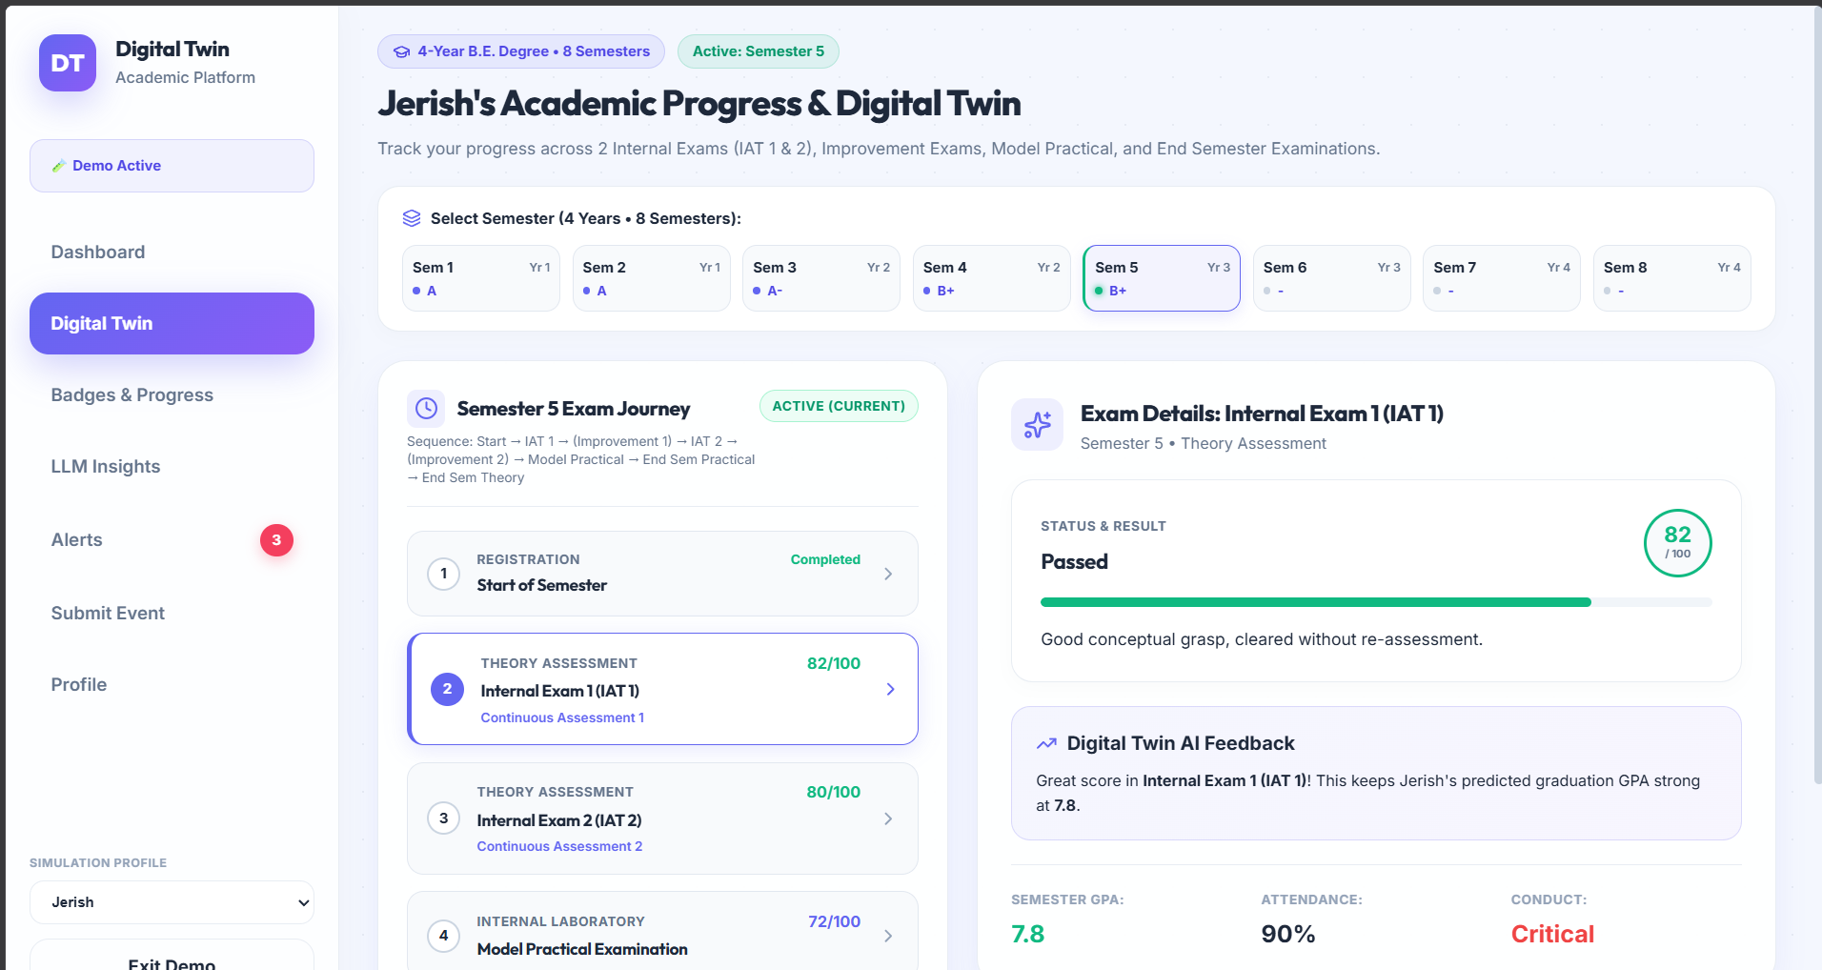
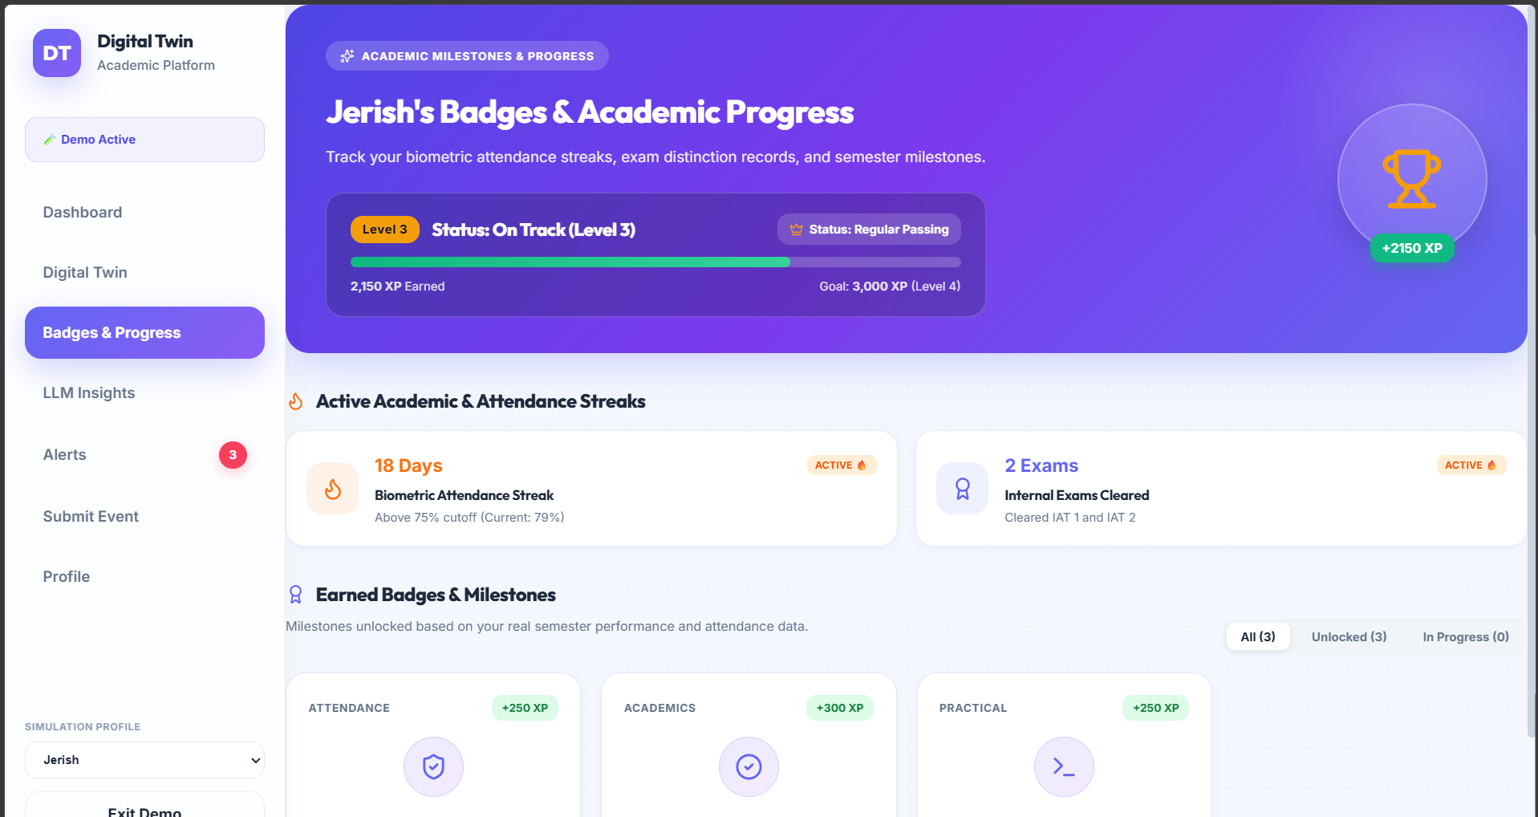
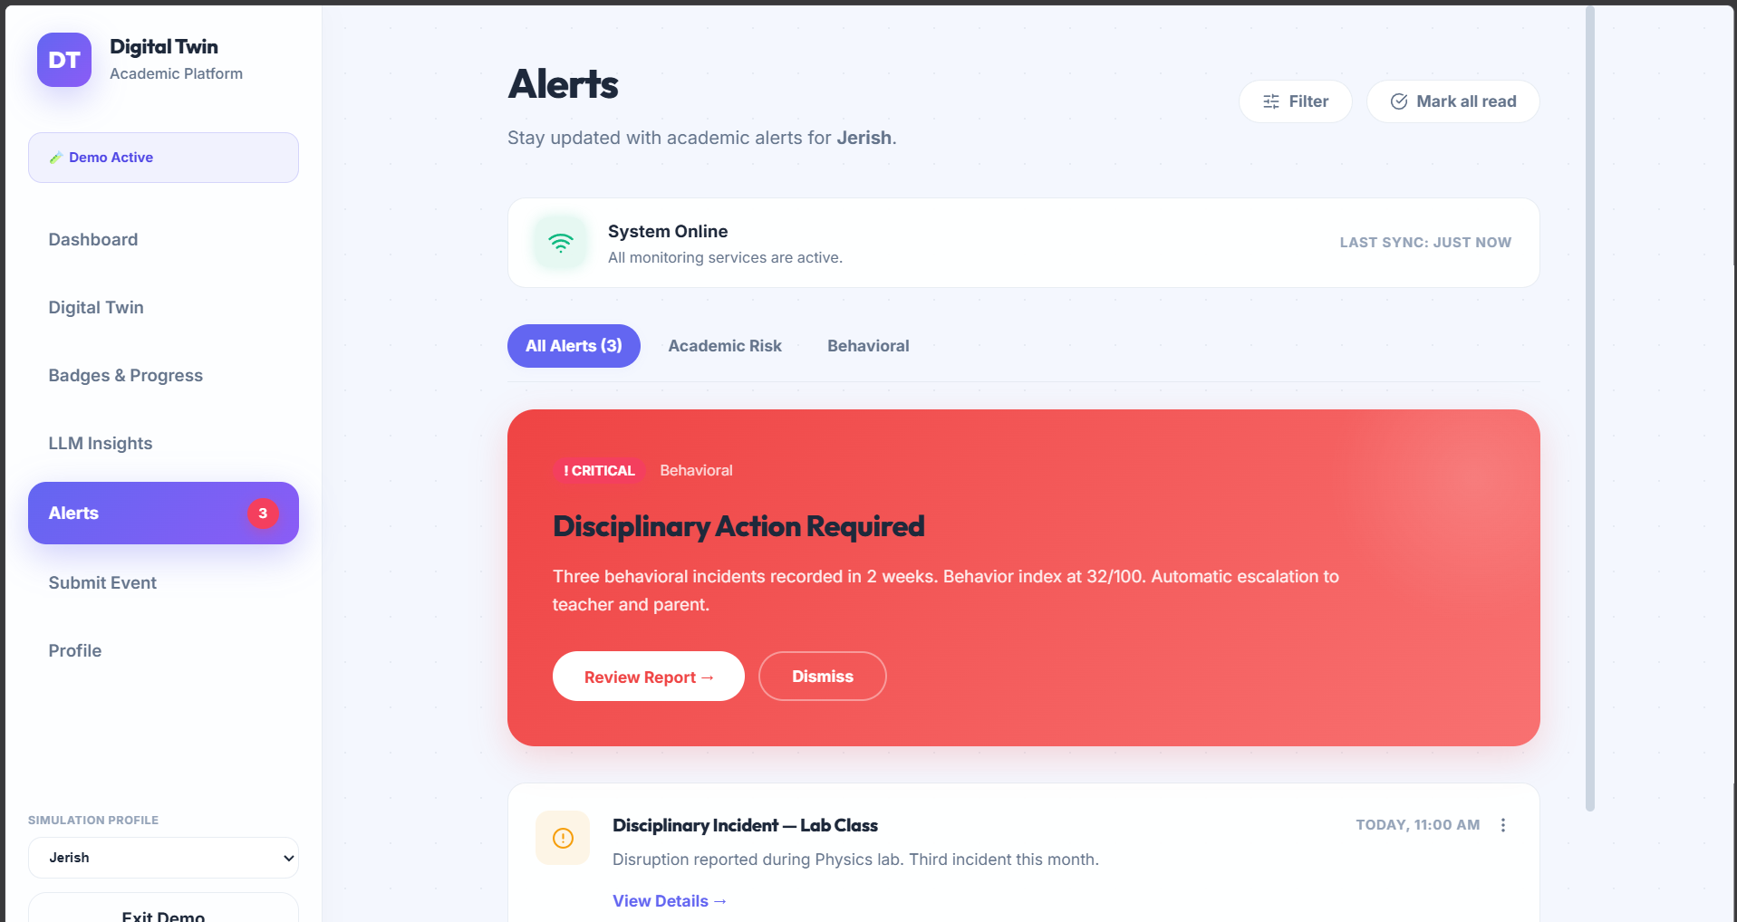
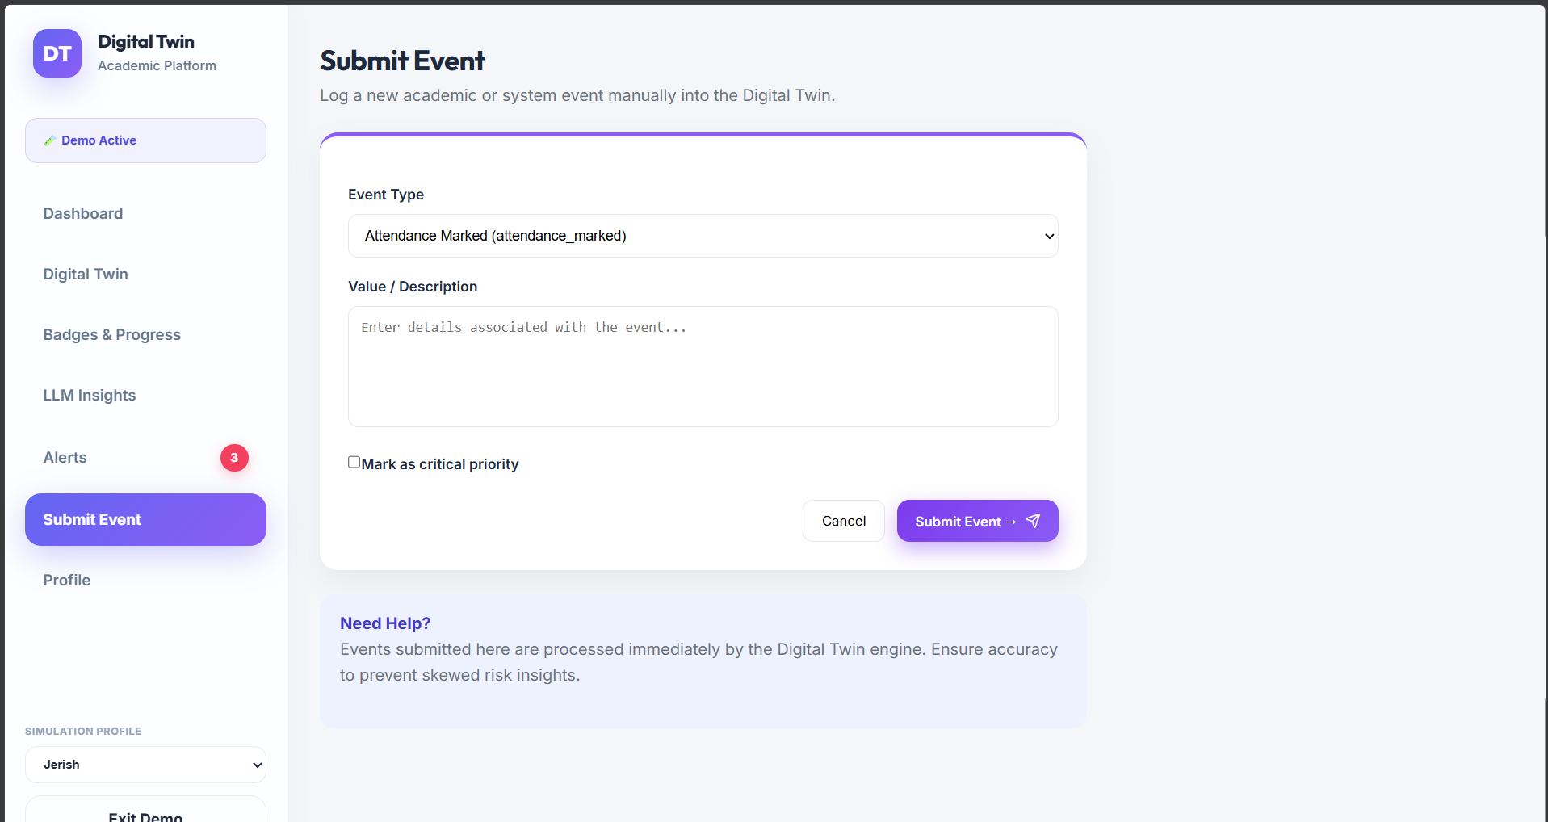
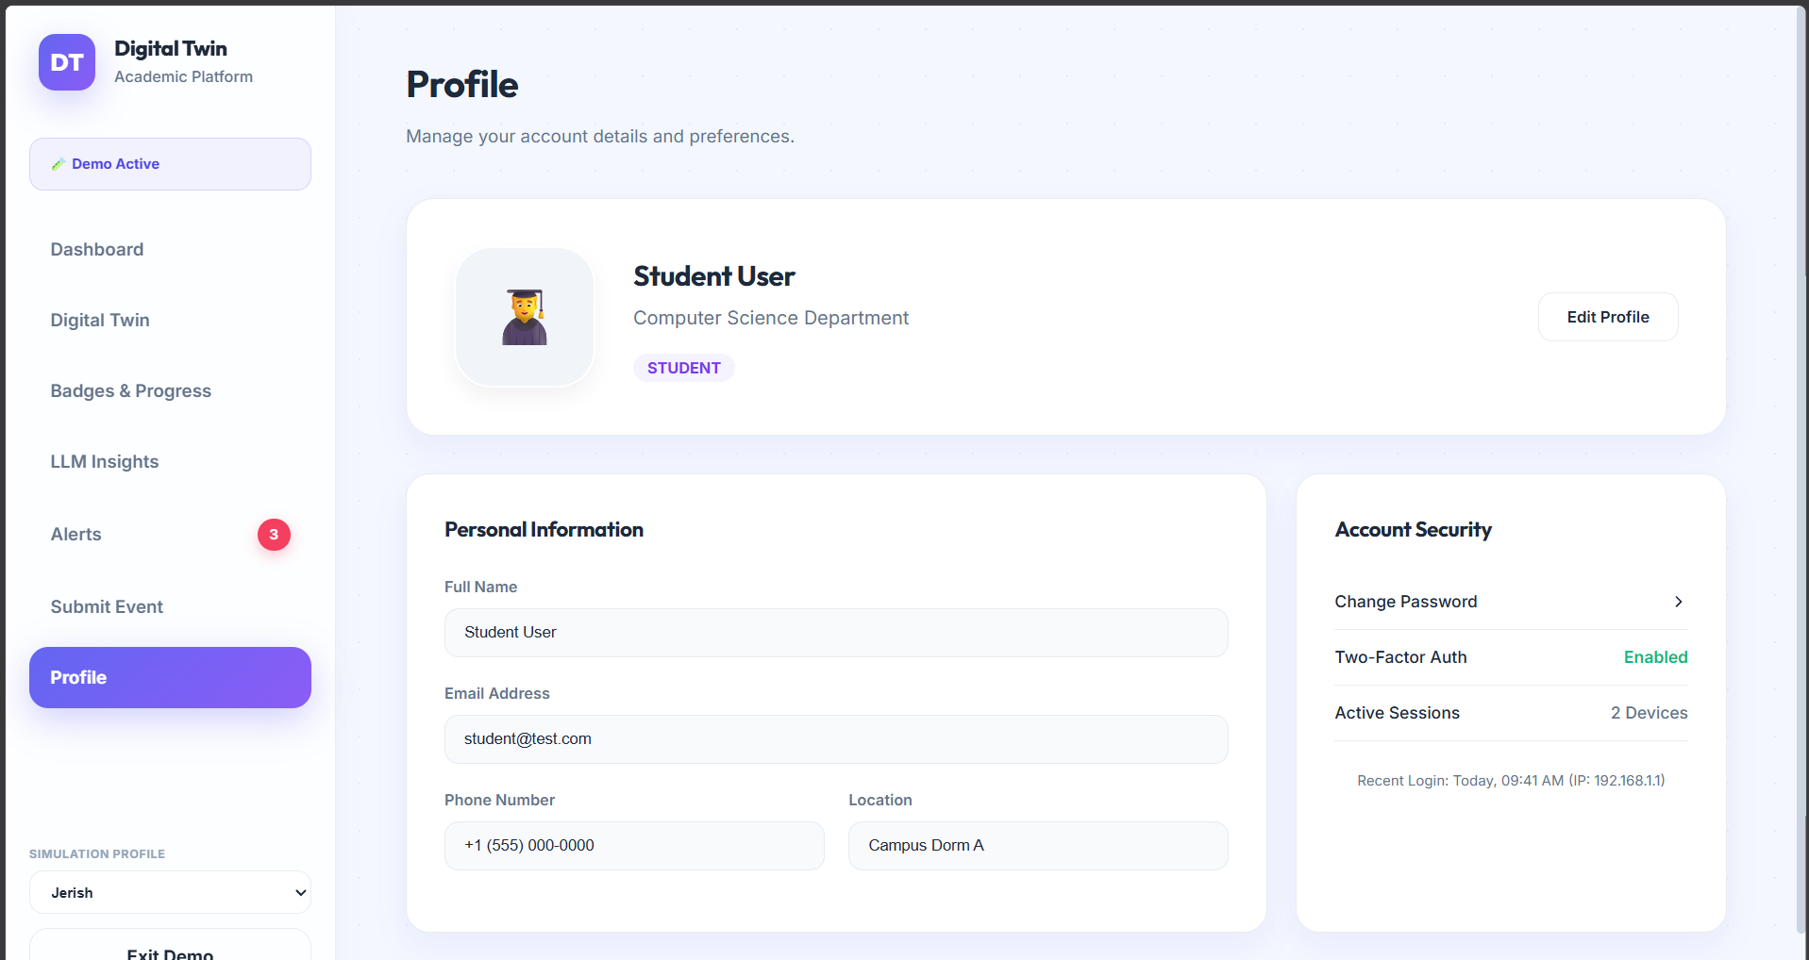
Output Screenshots(Desktop)
1. Student Dashboard
2. Digital Twin – semester progress
3. Badges & Progress
4. Alerts
5. Submit Event
6. Profile
Screenshots from the running prototype in demo / simulation mode.
Notes:
These are sample outputs from our running prototype. First, the student dashboard with predicted CGPA, attendance, risk and a marks trend with forecast. Second, the digital twin page with semester-wise progress and exam details. Third, badges and progress, our gamified rewards. Fourth, alerts, where a critical behaviour alert can be reviewed or dismissed. Fifth, the submit event form that sends a new event to the twin. Sixth, the profile page. All screens are from demo mode with simulated student profiles.

Slide 18
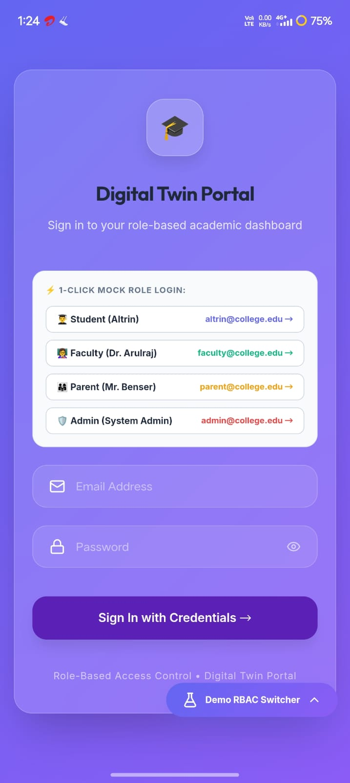
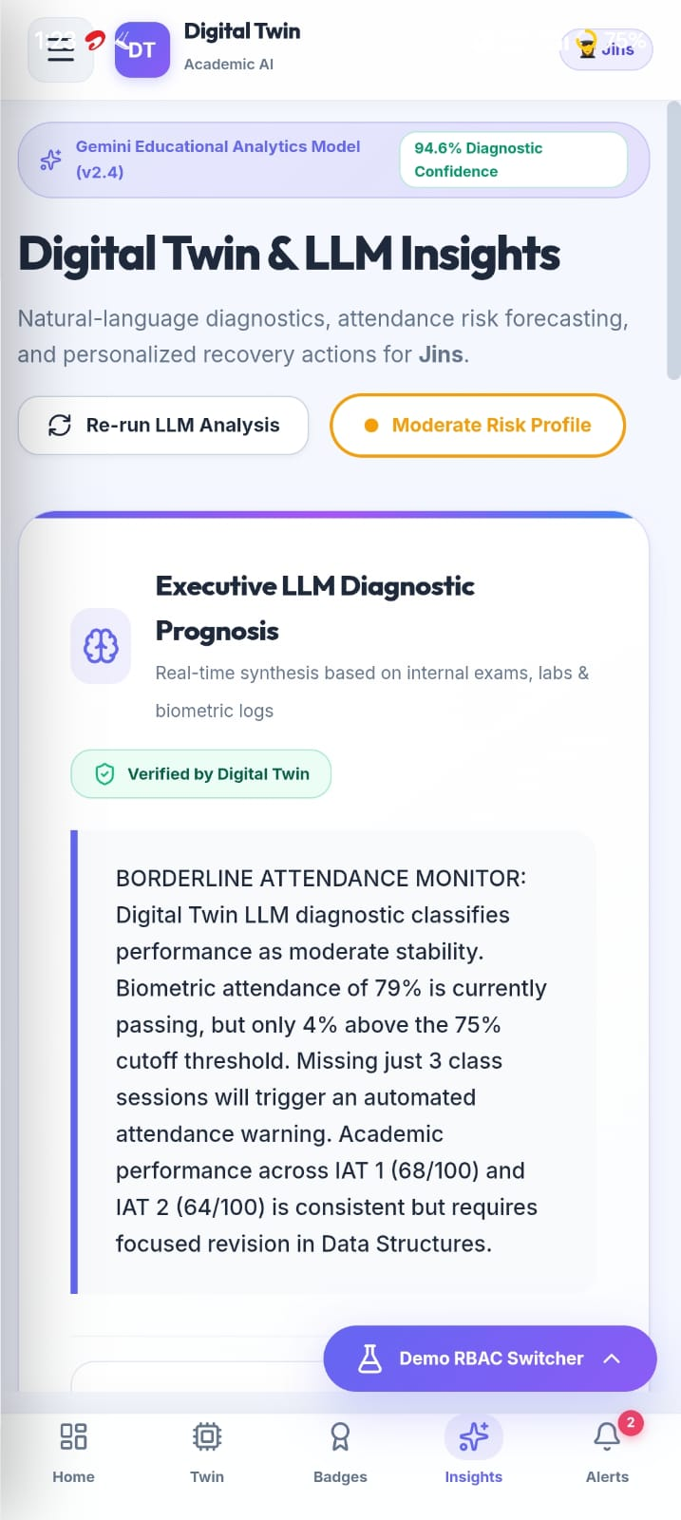
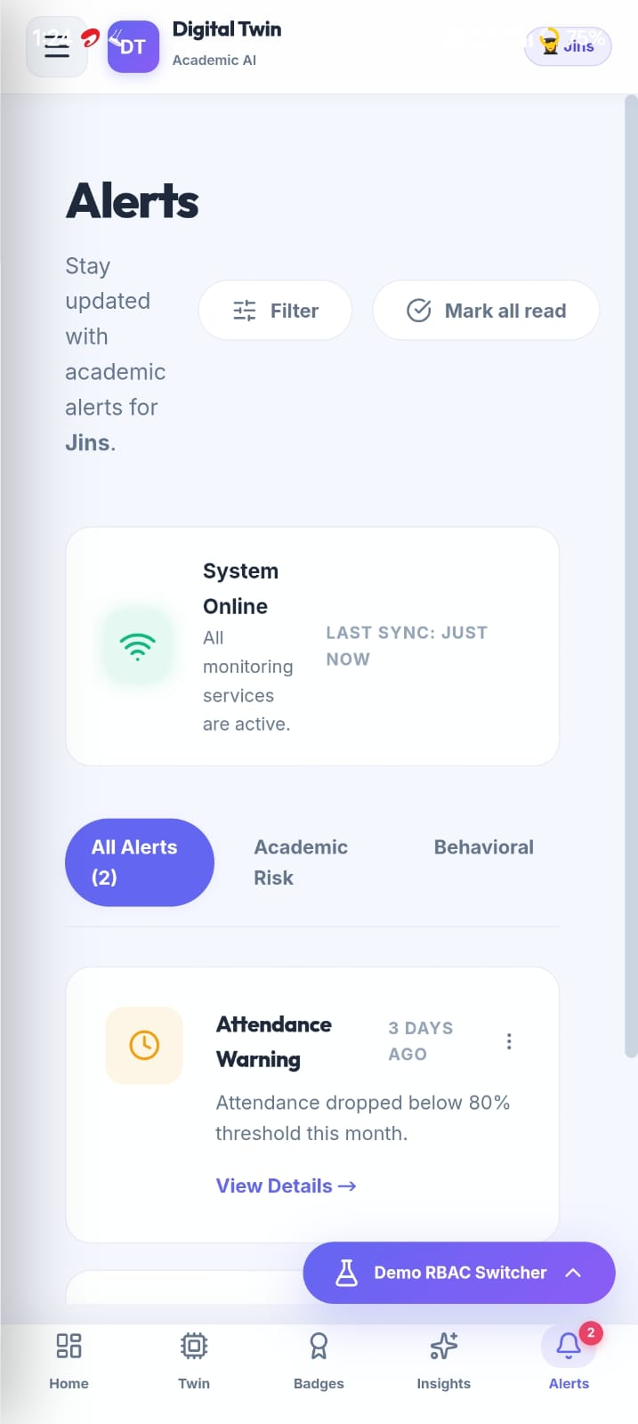
Output Screenshots(Mobile)

Slide 19
Conclusion
Conclusion
Built Digital Class Twin using FastAPI, SQLite, and React 18 to identify at-risk students early before end-semester exams.
Continuously tracks daily attendance, CIA marks, lab scores, and conduct using a 30-day rolling window.
Calculates an explainable Health Score (0–100) (50% Academic + 30% Attendance + 20% Conduct) and classifies students into Stable, Warning, or Critical with a 3.0-point hysteresis buffer.
Uses Random Forest (risk prediction), Ridge Regression (SGPA/CGPA forecast), and a live What-If Simulator to help students meet the 75% Anna University attendance limit.
Future Work
Multi-Semester ML Training: Train XGBoost & Random Forest models on multi-year college datasets with SHAP explainers.
Database & Scalability Upgrade: Migrate from SQLite to PostgreSQL with Celery & Redis background task queues for campus-wide deployment.
Automated Parent Alerts: Integrate real-time SMS, Email, and WhatsApp alerts for parents and faculty mentors.
Mobile App & ERP Integration: Launch a dedicated Mobile App and sync directly with college ERP / LMS platforms.

Slide 20
Participation in Technical Event
Presented at
“International Comference on Advancements in Education, Science, Engineering and Management(ICAESEM 2026)”, B.S.A(P.G) College, Mathura, Uttar Pradesh
October 30–31, 2026

Slide 21
References
Cagliero et al. (2021). Predicting Student Academic Performance by Means of Associative Classification.
Karalar et al. (2021). Predicting Students at Risk of Academic Failure Using Ensemble Model During Pandemic in a Distance Learning System.
Park & Yoo (2021). Early Dropout Prediction in Online Learning of University Using Machine Learning.
Dabhade et al. (2021). Educational Data Mining for Predicting Students’ Academic Performance Using Machine Learning Algorithms.
Tamada et al. (2022). Predicting Students at Risk of Dropout in Technical Course Using LMS Logs.
Yağcı (2022). Educational Data Mining: Prediction of Students’ Academic Performance Using Machine Learning Algorithms.
Oqaidi et al. (2022). Towards a Students’ Dropout Prediction Model in Higher Education Institutions Using Machine Learning Algorithms.
Segura et al. (2022). Machine Learning Prediction of University Student Dropout: Does Preference Play a Key Role?
Katsuragi & Tanaka (2022). Dropout Prediction by Interpretable Machine Learning Model Towards Preventing Student Dropout.
Su et al. (2022). Applying Machine Learning Technologies to Explore Students’ Learning Features and Performance Prediction.
Plak et al. (2022). Early Warning Systems for More Effective Student Counselling in Higher Education.
Qin et al. (2023). Early Warning of Student Performance With Integration of Subjective and Objective Elements.
Cho et al. (2023). A Study on Dropout Prediction for University Students Using Machine Learning.
Balcıoğlu & Artar (2023). Predicting Academic Performance of Students with Machine Learning.
Nagy & Molontay (2023). Interpretable Dropout Prediction: Towards XAI-Based Personalized Intervention.
Villar & Robledo Velini de Andrade (2024). Supervised Machine Learning Algorithms for Predicting Student Dropout and Academic Success: A Comparative Study.
Vaarma & Li (2024). Predicting Student Dropouts with Machine Learning: An Empirical Study in Finnish Higher Education.
Tiukhova et al. (2024). Explainable Learning Analytics: Assessing the Stability of Student Success Prediction Models by Means of Explainable AI.
Miranda et al. (2024). Machine Learning’s Model-Agnostic Interpretability on the Prediction of Students’ Academic Performance in Video-Conference-Assisted Online Learning.
Alalawi et al. (2024/2025). An Extended Learning Analytics Framework Integrating Machine Learning and Pedagogical Approaches for Student Performance Prediction and Intervention.

